Slide 1
Biopsychosocial Review of Sleep Disorders
Student’s Name
Institutional Affiliations
Date

Slide 2
Introduction
The biopsychosocial model was introduced in 1977
The model concentrates on the interconnection between biology, psychology, and socio-environmental factors
The purpose of the model is to understand health and diseases better
Health psychologist can use the biopsychosocial model to encourage health
The sleep disorder can be understood well through the model
Notes:
The field of biopsychosocial has gained tremendous research for the past few years. The biopsychosocial model was first presented by Jon Romano and George Engel in 1977. Therefore, it was demonstrated that the model focuses mainly on the relationship between biology, socio-environment, and psychological factors. Health psychologists can utilize the model in understanding the interconnectedness of the three fields and comprehend the idea between health and diseases. Furthermore, they can also use the model in encouraging healthy behaviors, stop conditions, and progress healthcare systems. Sleep disorder is part of an illness that is significant to all populations, including children and adults; thus, the model can solve it.

Slide 3
Introduction Cont…
The presentation will focus with the biopsychosocial perspective of sleep disorder
The benefits of having quality sleep are discussed
The biopsychosocial causes of sleep disorder presented
Most common sleep disorder listed and explained
Treatment options presented
Notes:
This presentation will focus on the biopsychosocial perspective of sleep disorder. Sleep problem is at a higher rate because most United States citizens do not receive quality sleep. The benefits of sleep-in the human body are significant; this leads to substantial effects when individuals lack quality sleep. The presentation will look at psychological, social and biological causes of sleep disorder and describe the most common sleep disorders that individuals face. Many people do not always know if they have a sleep disorder. Therefore, the presentation will also look at the symptoms and discuss the treatment methods of sleep problems.

Slide 4
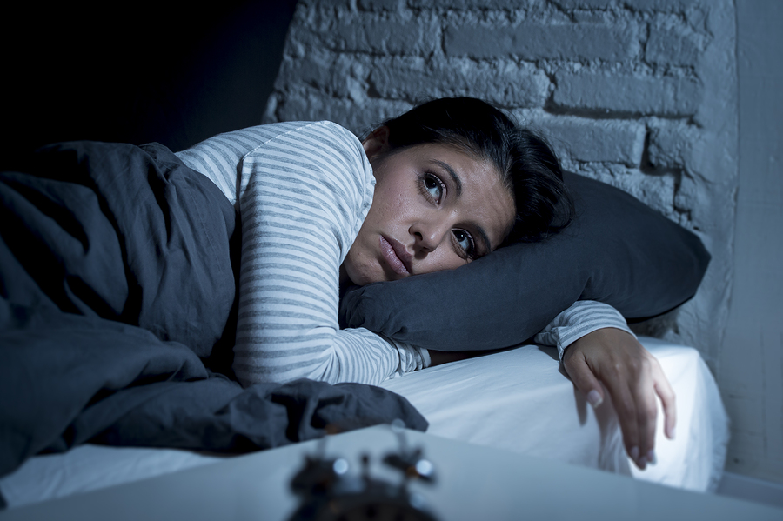
Sleep Disorder
Sleep disorder alters the usual pattern of an individual sleep
It affects the general health, safety, and quality of life
Sleep timing and duration are essential to be monitored
Over one-third of United States, adults have less than 7 hours of sleep within a day (Alexander et al., 2016)
Notes:
Sleep disorder is a common disease that people are facing in the current society. Although adults and children are the most affected population, sleep disorder affects a person's ability to receive frequent sleep, affecting sleep quality. When a regular sleep pattern is interfered with, the body will react differently, impacting individuals' general body health and safety and quality of life. Some individuals may suffer from sleep problems due to stress because they will keep thinking the whole night. Sleep timing and duration are essential in having quality sleep and thus need to be monitored. According to Alexander et al. (2016), over one-third of American adults have less than 7 hours of sleep within twenty-four hours.

Slide 5

Benefits of Quality Sleep
Enhancement of immunity
Promotes mental well-being
Stops diabetes
Improves mood
Preserves weight (Mindell & Williamson, 2018)
Notes:
Sleep is essential in individuals' bodies because of the immense benefits it has. For example, sleep enhances immunity because as people are sleep, the body tends to produce more protein molecules vital in improving the body's capacity to fight against diseases. Mental well-being is also enhanced because sleep acts as a method of decreasing stress. After all, the body cannot produce stress hormones. Also, the likelihood of a person having diabetes is reduced by having enough sleep. The mood is enhanced by good sleep; hence one can be calm, reasonable, and controlled. According to Mindell & Williamson (2018), emphasized that sleep cannot help someone reduce weight. Still, it can assist in managing and maintaining it through decreasing cravings for foods with high calories.

Slide 6
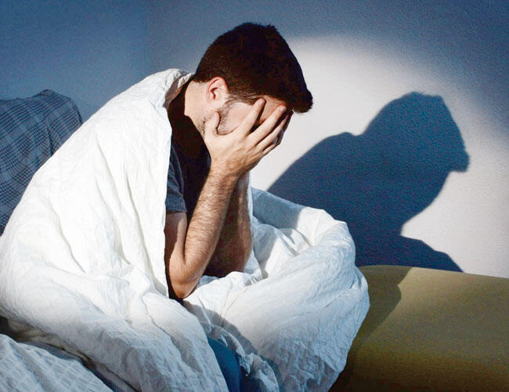
Symptoms of Sleep Disorder
Mood variations
Fatigue
Challenges staying asleep
Irritability
Struggle to concentrate or to recall
Notes:
Many people are not aware if they face sleep problems; however, understanding the general symptoms that a person experiences can realize if they have sleeping problems. Poor sleep will make individuals feel irritable and short-tempered. Furthermore, reduced sleep makes people susceptible to stress. Many people frequently suffer from fatigue when they did not have enough sleep because it is associated with sleep duration, sleep effectiveness, and the amount of time they were awake at night. People can also realize they have sleep disorder when facing challenges in falling asleep and irritability and stress when they do not get enough sleep. Sleep boosts an individual's memory, and thus experiencing struggles to remember or concentrate will be due to lack of sufficient sleep.

Slide 7

Biological Causes of Sleep Disorder
Acid reflux disorder
Dementia
Abnormal thyroid function
Conditions that enhance the urinary frequency
Notes:
Understanding how the body works require one to learn the biological components. Although all the biological research is conducted to improve the body's state, they also have specific side effects. Gastroesophageal reflux disease (GERD) is a chronic illness where the stomach acid moves up to the esophagus. Therefore, the coughing and choking will increase if an individual sleeps hence affecting sleep. Dementia affects the quality of sleep; however, more sleep problems increase as it continues to be severe. Excessive production of hormones leads to an intense thyroid that causes anxiety and Insomnia. Conditions such as enlarged prostate have resulted in poor sleep as those individuals will take more time to go to the restroom at night.

Slide 8
Medications and Substances that Can Disrupt Sleep
Stimulants such as caffeine
Alcohol
Some steroids such as prednisone (Miner & Kryger, 2017)
Beta-blockers
Notes:
Sleep problems can occur because of various situations; nevertheless, some medicines and substances can affect individuals' sleep patterns through the biopsychosocial model. Stimulants such as caffeine have substantial effects on individuals sleep because it causes delays in body sleep timing, thus impacting the overall sleep time. Alcohol decreases the time a person takes to have fall sleep, reducing the REM sleep and increasing the slow-wave rest. According to Miner & Kryger (2017), prednisone is a high anti-inflammatory and immune suppressor. It can lead to an actual insomnia rate in individuals who take it, especially at a higher dose. Similarly, beta-blockers are linked with sleep problems because it impedes the secretion of melatonin hormone which is essential for controlling sleep.

Slide 9

Psychological Causes of Sleep Disorder
Stress
Depression (Friedrich & Schlarb, 2018)
Tension
Sadness
Anxiety
Notes:
Psychologists have worked to understand how the mind functions, and this is linked with what they need. Therefore, the psychological factors that affect the human body can cause sleep disorders. Therefore, people may suffer from stress in various ways, such as issues in school or work. Family-related matters and finance can also make them stressed hence keeping them awake at night while thinking. Individuals suffering from depression have a high chance of not staying awake at night and feeling sleepiness in the daytime (Friedrich & Schlarb, 2018). Tension makes people develop fear in their life hence lacking proper sleep at night. Sad individuals tend to sleep more at night and fell asleep in the daytime. Similarly, anxiety is regularly linked with sleep disorders because it creates fear, affecting sleep length at night.

Slide 10

Sociological Causes of Sleep Disorder
Family conflict (Meadows et al., 2018)
Technology such as using social media
Environment circumstances
Notes:
The more individuals interact with each other, their environment significantly affects their length and quality of sleep. Therefore, individuals need to interact with each other to make them peaceful and enjoy their day. However, in some situations, family and work conflict may make people stressed and hence interfere with sleep at night (Meadows et al., 2018). Stress is directly related to sleep. Also, technology has emerged at a high rate, and people can now socialize through social media across the world; this makes individuals prolong their night and alter the length of sleep. Likewise, the environmental circumstance can affect individuals' sleep, such as a crowded place which might be uncomfortable to sleep.

Slide 11
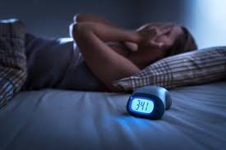
Most Common Sleep Disorders
Sleep apnea
Narcolepsy
Insomnia (McArdle et al., 2020)
REM sleep behavior disorder
Restless leg syndrome
Notes:
Sleeping disorders are prevalent in the present society at an alarming rate. While many people do not realize they have it, but they understand the trouble of falling asleep. According to McArdle et al. (2020), sleep problems have impacted between fifty to seventy million Americans, with Insomnia being the most prevalent illness. Other sleep disorders common in the United States are Narcolepsy, sleep apnea, REM sleep behavior disorder, and restless leg syndrome. Nevertheless, to understand which disease an individual has, they must be diagnosed with their physician and then be given proper sleep and therapeutic advice. One should take when they realize they have symptoms that are similar to sleep disorders.

Slide 12
Insomnia
Challenge in getting sleep or staying asleep
Transient Insomnia (Matheson & Hainer, 2017)
Chronic Insomnia
Poor sleep hygiene
Quality of life and social life affected
Notes:
Insomnia is the most prevalent sleep disorder in the United States. The condition is linked with the problem of individuals getting sleep or staying asleep at night. Therefore, insomnia disorder is in two different categories, including transient and chronic Insomnia. According to Matheson & Hainer (2017), transient Insomnia, which is also called short-term Insomnia, frequently happens after an individual has gone through stressful activities in their life, such as a relationship breakup. On the other hand, chronic Insomnia is related to features such as non-restorative sleep events and challenges are falling asleep and maintaining it for more than one month. One of the reasons for Insomnia is poor sleep hygiene that makes the body restless. Insomnia can reduce the quality of life and social life of an individual.

Slide 13
Sleep Apnea
The airway frequently becomes blocked
Individuals stop breathing
Choke noise occur or snore noisily
The body becomes oxygen deficiency
The problem can occur at least once a night
Notes:
Sleep Apnea is a solemn sleep problem, and it is dominant in societies. The disease is accompanied by the airways of individuals regularly becoming blocked while asleep. This will trigger an individual to wake up because they will stop breathing. Breathing is an essential part of a person's life because it helps in the supply of oxygen. Since the airway s blocked, an individual will make choke noises or snore in a loud voice. Consequently, the patient's body will be oxygen-deficient as no oxygen supplied is available. Although the problem might occur at least once a night, it might happen more than five times in severe circumstances, affecting the sleep pattern of an individual.

Slide 14

Narcolepsy
The condition makes someone sleep without notice (Kornum et al., 2017)
Individuals unable to control their sleep-wake cycle
Feel tired in the daytime
Make people agonize from sleep paralysis
Notes:
According to Kornum et al. (2017), Narcolepsy is a sleeping condition that causes individuals to sleep anytime and anywhere. Therefore, this condition does not provide notice to individuals concerning their sleep. The sleep pattern is altered, and thus the individuals cannot control their sleep-wake cycle. It is challenging because it can make a person fall asleep in uncommon situations, such as eating. Furthermore, during the day, patients will feel tired and sleepy more than at night. Also, individuals can agonize from sleep paralysis. Sleep paralysis is when a person is incapable of moving, and it happens when they wake up from sleep.

Slide 15
REM Sleep Behavior Disorder
Individuals act on their dreams while at sleep (Bassetti & Bargiotas, 2018)
No sleep paralysis like other people when sleeping
Taken seriously when it causes harm to the person or others around them
Examples include talking and screaming while sleeping
Notes:
Bassetti & Bargiotas (2018) emphasized that REM disorder is associated with individuals' behavior moving their body and performing actions in their dream. People can work on activities physically and react differently. During REM sleep individuals, most individuals tend to have sleep paralysis, which will make their bodies not move. However, those with this condition can move their body and even walk at night. Nevertheless, the disease is taken seriously when it causes harm to an individual or other people around. REM behavior disorder is slow and can get worse over time. An example of REM behavior disease is talking or screaming while in sleep.

Slide 16

Restless Leg Syndrome
Sturdy desires to move the legs
Feeling that starts after relaxation
The feeling is calmed after movement (Memon et al., 2020)
Nighttime leg jolting
Notes:
Restless leg syndrome is another common sleep problem. The disease is associated with irrepressible desires to move the legs. The painful feeling on the legs triggers the movement of the legs. Although these activities might occur in the evening, they regularly happen when a person is sleeping. Movement of the legs reduces the uncomfortable feeling momentarily. Moreover, according to Memon et al. (2020), the condition can start at any age and continue to occur until it becomes severe as a person ages; it can be calmed down by moving the legs. Also, restless leg syndrome can disturb sleep and affects the daily activities of an individual.

Slide 17
Diagnosis of Sleep Disorders
Physical examination
Multiple sleep latency tests (MSLT) (Smith et al., 2018)
Polysomnography (PSG)
Electroencephalogram (EEG)
Notes:
When individuals realize they have sleep disorder symptoms, they will report to their physicians, and they will be referred to the sleep physician. The sleep physician will then perform a physical evaluation of the patient based on the concerns presented. Other tests will be conducted, such as MSLT, which is used to diagnose narcolepsy disorder and is done during the day together with PSG (Smith et al., 2018). Another test is PSG which is used to recognize sleep apnea when conducted at home and in the lab to detect oxygen levels and body actions that affect sleep. EEG is also a test for evaluating electrical events in the brain and perceives the possibilities' likelihood. This test is an element of PSG.

Slide 18

Medical Treatment of Sleep Disorder
Breathing instruments or surgery (Bonsignore et al., 2017)
Melatonin supplements
Therapeutic for any causal health problem
Sleeping pills
Notes:
Both medical and lifestyle methods can treat individuals suffering from sleep disorders. For example, sleep apnea can be used breathing instruments such as didgeridoo, which will help in breathing problems. According to Bonsignore et al. (2017), the devices can reduce snoring and decrease sleep disruption. The same source emphasized that surgery involves the removal of extra tissue in the pharynx and soft palate. Melatonin supplements normalize a person's clock and make them ready for sleep as its level increases at night. Treatment of health problems that leads to sleep problems can be treated and eliminate the problem of sleep. Individuals can also be boosted by sleeping pills that will make them enjoy REM sleep.

Slide 19
Lifestyle Change Treatment for the Sleep Disorder
Decrease stress through exercise (Tanaka & Tamura, 2016)
Develop a consistent sleeping plan
Preserve weight as recommended by the physician
Eat meals with low carbohydrates before sleeping
Reduce caffeine use, particularly in the evening
Notes:
Quality sleep is attained based on the events that individuals do in their daily activities. Therefore, when they alter their lifestyle, people can enjoy long rest that can improve their well-being. According to Tanaka & Tamura (2016), exercise and stretching could reduce anxiety and stress, hence enhancing sleep quality. There will be no night disturbances that are accompanied by thinking and worries. Also, individuals need to develop a sleep plan to ensure they get to bed on time to ensure their sleep length is maintained. Weight is essential and disturbing, significantly when it increases or reduces than usual, hence keeping the recommended weight. Meals have a substantial effect on sleep; eating foods with fewer carbohydrates will improve sleep. Caffeine should be reduced significantly in the evening and afternoons.

Slide 20

Effects of Insufficient Sleep in the Body
Accidents
Reduced sex drive (Sweatt et al., 2018)
Inadequate balance
Notes:
Individuals with sleep challenges have increased risks of being drowsy, especially the drivers, which will make them lose attention, make quick decisions, and respond fast, hence causing accidents. Therefore, individuals should not use machinery or drive when they feel sleepy. Individuals with insufficient sleep always have less libido because poor sleep is connected with erectile dysfunction for men and arousal challenges and orgasm problems for women (Sweatt et al., 2018). The reduced sex drive is associated with reduced testosterone levels. Poor sleep can result o significant challenges in the balance because it can lead to inadequate coordination, making someone vulnerable o falls and other accidents.

Slide 21
Conclusion
The biopsychosocial model was introduced in 1977 by Jon Romano and George Engel
The model utilizes biological, psychological, and socio-environment factors
The model is widely used in health to understand illness such as sleep disorder
Sleep disorder is caused by all the three factors such as family conflict, depression, and dementia
The most common types of sleep disorder are Insomnia, sleep apnea, RLS, REM sleep behavior disorder, and Narcolepsy
Treatment includes medical and lifestyle change
Notes:
In summation, the concept of biopsychosocial was first introduced in 1977 by George Engel and Jon Romano. Therefore, the idea has now developed into a model and links the relationship between biological, sociological, and psychological concepts in understanding health matters such as diseases. The presentation has used the biopsychosocial model to understand sleep disorder, and thus biological, sociological, and psychological causes are expressed, such as dementia, family conflict, and depression, respectively. Similarly, the most common sleep disorder is explained with Insomnia being the most prevalent in the United States, followed by sleep apnea, Narcolepsy, RLS, and REM sleep behavior. Also, treatment methods are mentions based explicitly on medical and lifestyle changes.

Slide 22
References
Alexander, M., Ray, M. A., Hébert, J. R., Youngstedt, S. D., Zhang, H., Steck, S. E., ... & Burch, J. B. (2016). The national veteran sleep disorder study: descriptive epidemiology and secular trends, 2000–2010. Sleep, 39(7), 1399-1410.
Bassetti, C. L., & Bargiotas, P. (2018). REM sleep behavior disorder. Neurologic-Psychiatric Syndromes in Focus-Part I, 41, 104-116.
Bonsignore, M. R., Giron, M. C. S., Marrone, O., Castrogiovanni, A., & Montserrat, J. M. (2017). Personalised medicine in sleep respiratory disorders: focus on obstructive sleep apnoea diagnosis and Treatment. European Respiratory Review, 26(146).
Friedrich, A., & Schlarb, A. A. (2018). Let's talk about sleep: a systematic review of psychological interventions to improve sleep in college students. Journal of Sleep Research, 27(1), 4-22.
Kornum, B. R., Knudsen, S., Ollila, H. M., Pizza, F., Jennum, P. J., Dauvilliers, Y., & Overeem, S. (2017). Narcolepsy. Nature reviews Disease primers, 3(1), 1-19.

Slide 23
References Cont…
Matheson, E., & Hainer, B. L. (2017). Insomnia: pharmacologic therapy. American family physician, 96(1), 29-35.
McArdle, N., Ward, S. V., Bucks, R. S., Maddison, K., Smith, A., Huang, R. C., ... & Eastwood, P. R. (2020). The prevalence of common sleep disorders in young adults: a descriptive population-based study. Sleep, 43(10), zsaa072.
Meadows, R., Williams, S. J., Gabe, J., Coveney, C., & Arber, S. (2018). The sociology of sleep. Sleep, health and society: From aetiology to public health, 171-178.
Memon, M. D., Faiz, S., Zaveri, M. P., Perry, J. C., Schuetz, T. M., & Cancarevic, I. (2020). Unraveling the Mysteries of Restless Leg Syndrome. Cureus, 12(10).
Mindell, J. A., & Williamson, A. A. (2018). Benefits of a bedtime routine in young children: Sleep, development, and beyond. Sleep medicine reviews, 40, 93-108.

Slide 24
References Cont…
Miner, B., & Kryger, M. H. (2017). Sleep in the aging population. Sleep medicine clinics, 12(1), 31-38.
Smith, M. T., McCrae, C. S., Cheung, J., Martin, J. L., Harrod, C. G., Heald, J. L., & Carden, K. A. (2018). Use of actigraphy for the evaluation of sleep disorders and circadian rhythm sleep-wake disorders: an American Academy of Sleep Medicine clinical practice guideline. Journal of Clinical Sleep Medicine, 14(7), 1231-1237.
Sweatt, S. K., Gower, B. A., Chieh, A. Y., Liu, Y., & Li, L. (2018). Sleep quality is differentially related to adiposity in adults. Psychoneuroendocrinology, 98, 46-51.
Tanaka, H., & Tamura, N. (2016). Sleep education with self-help treatment and sleep health promotion for mental and physical wellness in Japan. Sleep and biological rhythms, 14(1), 89-99.

